Slide 1
DATA MODELING
USING
ER MODEL
AND ITS EXTENSIONS
(Part I)

Slide 2
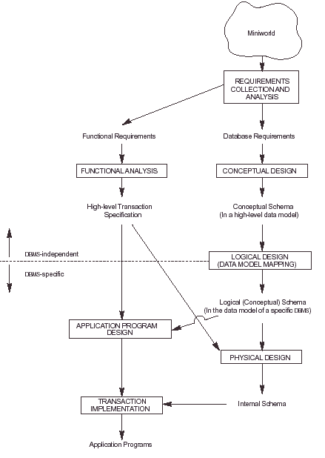
Main Phases of Database Design ( ref 3.1)

Slide 3
OUTLINE
Example Database Application (COMPANY)
ER Model Concepts
  Entities and Attributes
  Entity Types, Value Sets, and Key Attributes
  Relationships and Relationship Types
  Weak Entity Types
  Roles and Attributes in Relationship Types
ER Diagrams- Notation
ER Diagram for COMPANY Schema

Slide 4
Example COMPANY Database (ref 3.2)
Requirements of the Company (oversimplified for illustrative purposes)
  The company is organized into DEPARTMENTs. Each department has a name, number and an employee who manages the department. We keep track of the start date of the department manager. A department may have several locations.
  Each department controls a number of PROJECTs. Each project has a name, number and is located at a single location.

Slide 5
Example COMPANY Database (Cont.)
  We store each EMPLOYEE’s social security number, address, salary, sex, and birthdate. Each employee works for one department but may work on several projects. We keep track of the number of hours per week that an employee currently works on each project. We also keep track of the direct supervisor of each employee.
  Each employee may have a number of DEPENDENTs. For each dependent, we keep track of their name, sex, birthdate, and relationship to employee.

Slide 6
ER Model Concepts (ref 3.3)
Entities and Attributes
  Entities are specific objects or things in the mini-world that are represented in the database. For example, the EMPLOYEE John Smith, the Research DEPARTMENT, the ProductX PROJECT
  Attributes are properties used to describe an entity. For example, an EMPLOYEE entity may have a Name, SSN, Address, Sex, BirthDate
  A specific entity will have a value for each of its attributes. For example, a specific employee entity may have Name=‘John Smith’, SSN=‘123456789’,
  Address=‘731 Fondren, Houston, TX’, Sex=‘M’, BirthDate=‘17-Aug-1955’
  Each attribute has a value set (or data type) associated with it – e.g. integer, string, subrange, enumerated type, …

Slide 7
Types of Attributes (1)
Simple
  Each entity has a single atomic value for the attribute. For example, SSN or Sex.
Composite
  The attribute may be composed of several components. For example, Address (Apt#, House#, Street, City, State, ZipCode, Country) or Name (FirstName, MiddleName, LastName). Composition may form a hierarchy where some components are themselves composite.
Multi-valued
  An entity may have multiple values for that attribute. For example, Color of a CAR or PreviousDegrees of a STUDENT. Denoted as {Color} or {PreviousDegrees}.

Slide 8
Types of Attributes (2)
Complex Attributes:
  In general, composite and multi-valued attributes may be nested arbitrarily to any number of levels although this is rare. For example, PreviousDegrees of a STUDENT is a composite multi-valued attribute denoted by {PreviousDegrees (College, Year, Degree, Field)}.
Stored vs Derived:
  In some cases two or more attribute values are related e.g. Age (derived) and Birth_date(stored)
NULL Values:
  In some cases a particular attribute may not have an applicable value for an attribute e.g. apartment_number attribute of an address applies only to addresses that are in apartment buildings

Slide 9
Entity Types and Key Attributes
Entities with the same basic attributes are grouped or typed into an entity type. For example, the EMPLOYEE entity type or the PROJECT entity type.
An attribute of an entity type for which each entity must have a unique value is called a key attribute of the entity type. For example, SSN of EMPLOYEE.
A key attribute may be composite. For example, VehicleTagNumber is a key of the CAR entity type with components (Number, State).
An entity type may have more than one key. For example, the CAR entity type may have two keys:
  VehicleIdentificationNumber (popularly called VIN) and
  VehicleTagNumber (Number, State), also known as license_plate number.

Slide 10
ENTITY SET corresponding to the
ENTITY TYPE CAR
CAR
Registration(RegistrationNumber, State), VehicleID, Make, Model, Year, {Color}
car₁
((ABC 123, TEXAS), TK629, Ford Mustang, convertible, 1989, {red, black})
car₂
((ABC 123, NEW YORK), WP9872, Nissan Sentra, 2-door, 1992, {blue})
car₃
((VSY 720, TEXAS), TD729, Chrysler LeBaron, 4-door, 1993, {white, blue})
.
.
.

Slide 11
SUMMARY OF ER-DIAGRAM
NOTATIONS FOR ER SCHEMAS (fig 3.14)
Symbol
Meaning
ENTITY TYPE
WEAK ENTITY TYPE
RELATIONSHIP TYPE
IDENTIFYING RELATIONSHIP TYPE
ATTRIBUTE
KEY ATTRIBUTE
MULTIVALUED ATTRIBUTE
COMPOSITE ATTRIBUTE
DERIVED ATTRIBUTE
TOTAL PARTICIPATION OF E₂ IN R
CARDINALITY RATIO 1:N FOR E₁:E₂ IN R
STRUCTURAL CONSTRAINT (min, max) ON PARTICIPATION OF E IN R
E₁
R
E₂
N
E₁
1
R
N
E₂
R
(min,max)
E

Slide 12
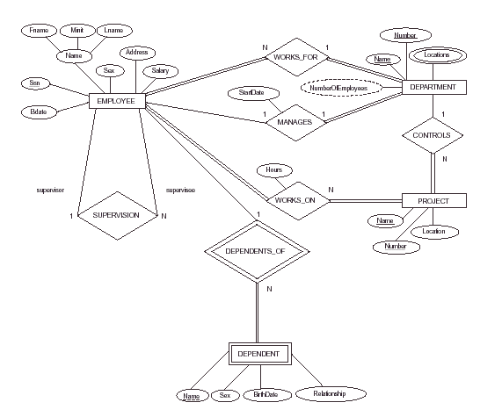
ER DIAGRAM – Entity Types are:
EMPLOYEE, DEPARTMENT, PROJECT, DEPENDENT

Slide 13
Relationships and Relationship Types (ref 3.4) (1)
A relationship relates two or more distinct entities with a specific meaning. For example, EMPLOYEE John Smith works on the ProductX PROJECT or EMPLOYEE Franklin Wong manages the Research DEPARTMENT.
Relationships of the same type are grouped or typed into a relationship type. For example, the WORKS_ON relationship type in which EMPLOYEEs and PROJECTs participate, or the MANAGES relationship type in which EMPLOYEEs and DEPARTMENTs participate.
The degree of a relationship type is the number of participating entity types. Both MANAGES and WORKS_ON are binary relationships.

Slide 14
Example relationship instances of the WORKS_FOR relationship between EMPLOYEE and DEPARTMENT
EMPLOYEE
WORKS_FOR
DEPARTMENT
e_{1 }
e_{2 }
e_{3 }
e_{4 }
e_{5 }
e_{6 }
e_{7 }
r₁
r₂
r₃
r₄
r₅
r₆
r₇
● d₁
● d₂
● d₃

Slide 15
Example relationship instances of the WORKS_ON relationship between EMPLOYEE and PROJECT
EMPLOYEE
WORKS_ON
PROJECT
e_{1 }
e_{2 }
e_{3 }
e_{4 }
e_{5 }
e_{6 }
e_{7 }
r₁
r₂
r₃
r₄
r₅
r₆
r₇
● p₁
● p₂
● p₃
r₈

Slide 16
Relationships and Relationship Types (2)
More than one relationship type can exist with the same participating entity types. For example, MANAGES and WORKS_FOR are distinct relationships between EMPLOYEE and DEPARTMENT, but with different meanings and different relationship instances.

Slide 17
ER DIAGRAM – Relationship Types are:
WORKS_FOR, MANAGES, WORKS_ON, CONTROLS,
SUPERVISION, DEPENDENTS_OF

Slide 18
Weak Entity Types (ref 3.5)
An entity that does not have a key attribute
A weak entity must participate in an identifying relationship type with an owner or identifying entity type
Entities are identified by the combination of:
  A partial key of the weak entity type
  The particular entity they are related to in the identifying entity type
Example:
Suppose that a DEPENDENT entity is identified by the dependent’s first name and birhtdate, and the specific EMPLOYEE that the dependent is related to. DEPENDENT is a weak entity type with EMPLOYEE as its identifying entity type via the identifying relationship type DEPENDENT_OF

Slide 19
Weak Entity Type is: DEPENDENT
Identifying Relationship is: DEPENDENTS_OF

Slide 20
Constraints on Relationships (ref 3.4.3)
Constraints on Relationship Types
  ( Also known as ratio constraints )
  Maximum Cardinality
    One-to-one
    One-to-many
    Many-to-many
  Minimum Cardinality (also called participation or existence dependency constraints)
    zero (optional/partial participation, not existence-dependent)
    one or more (mandatory/total participation, existence-dependent)

Slide 21
Many-to-one (N:1) RELATIONSHIP
EMPLOYEE
WORKS_FOR
DEPARTMENT
e_{1 }
e_{2 }
e_{3 }
e_{4 }
e_{5 }
e_{6 }
e_{7 }
r₁
r₂
r₃
r₄
r₅
r₆
r₇
● d₁
● d₂
● d₃

Slide 22
Many-to-many (M:N) RELATIONSHIP
EMPLOYEE
WORKS_ON
PROJECT
e_{1 }
e_{2 }
e_{3 }
e_{4 }
e_{5 }
e_{6 }
e_{7 }
r₁
r₂
r₃
r₄
r₅
r₆
r₇
● p₁
● p₂
● p₃
r₈

Slide 23
Relationships and Relationship Types (3)
We can also have a recursive relationship type.
Both participations are same entity type in different roles.
For example, SUPERVISION relationships between EMPLOYEE (in role of supervisor or boss) and (another) EMPLOYEE (in role of subordinate or worker).
In following figure, first role participation labeled with 1 and second role participation labeled with 2.
In ER diagram, need to display role names to distinguish participations.

Slide 24
A RECURSIVE RELATIONSHIP
SUPERVISION
EMPLOYEE
WORKS_FOR
e_{1 }
e_{2 }
e_{3 }
e_{4 }
e_{5 }
e_{6 }
e_{7 }
r₁
r₂
r₃
r₄
r₅
r₆
2
1
1
2
2
1
2
1
1
2
1
2

Slide 25
Recursive Relationship Type is: SUPERVISION
(participation role names are shown)

Slide 26
Attributes of Relationship types
A relationship type can have attributes; for example, HoursPerWeek of WORKS_ON; its value for each relationship instance describes the number of hours per week that an EMPLOYEE works on a PROJECT.

Slide 27
Attribute of a Relationship Type is:
Hours of WORKS_ON

Slide 28
Structural Constraints – one way to express semantics of relationships
Structural constraints on relationships:
Cardinality ratio (of a binary relationship): 1:1, 1:N, N:1, or M:N
  SHOWN BY PLACING APPROPRIATE NUMBER ON THE LINK.
Participation constraint (on each participating entity type): total (called existence dependency) or partial.
SHOWN BY DOUBLE LINING THE LINK
NOTE: These are easy to specify for Binary Relationship Types.

Slide 29
Alternative (min, max) notation for relationship structural constraints (ref 3.7.4):
Specified on each participation of an entity type E in a relationship type R
Specifies that each entity e in E participates in at least min and at most max relationship instances in R
Default(no constraint): min=0, max=n
Must have min≤max, min≥0, max ≥1
Derived from the knowledge of mini-world constraints
Examples:
A department has exactly one manager and an employee can manage at most one department.
  Specify (0,1) for participation of EMPLOYEE in MANAGES
  Specify (1,1) for participation of DEPARTMENT in MANAGES
An employee can work for exactly one department but a department can have any number of employees.
  Specify (1,1) for participation of EMPLOYEE in WORKS_FOR
  Specify (0,n) for participation of DEPARTMENT in WORKS_FOR

Slide 30
The (min,max) notation relationship constraints
(0,1)
(1,1)
Employee
Manages
Department
(1,1)
(1,N)
Employee
Department
Works-for

Slide 31
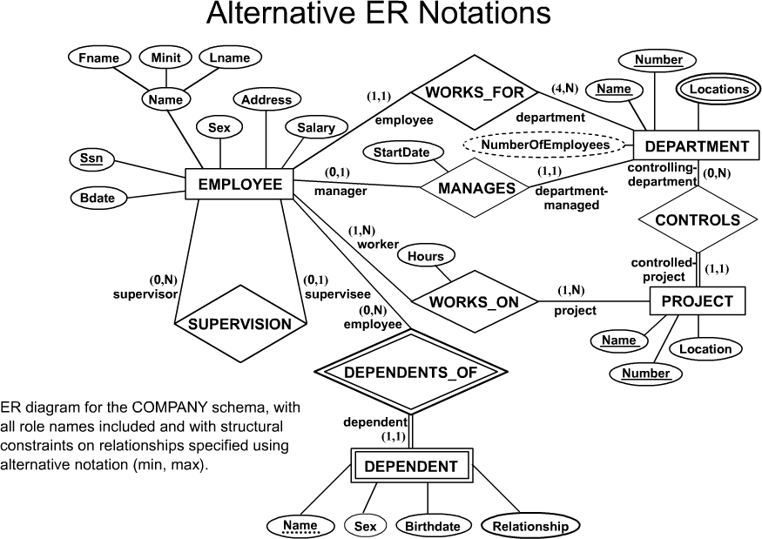
COMPANY ER Schema Diagram using (min, max) notation

Slide 32
Relationships of Higher Degree (ref 3.9)
Relationship types of degree 2 are called binary
Relationship types of degree 3 are called ternary and of degree n are called n-ary
In general, an n-ary relationship is not equivalent to n binary relationships

Slide 33
Choosing between Binary and Ternary (or higher-degree) relationships
A ternary relationship type represents different information than do three binary relationship types
The existence of three relationship instances (s, p), (j,p) and (s, j) in CAN_SUPPLY, USES and SUPPLIES in figure 3.17b respectively, does not imply that an instance (s, j, p) exists in the ternary relationship SUPPLY in figure 3.17a
If the database design tool used permits only binary relationships then the ternary relationship such as SUPPLY must be represented as a weak entity type with three identifying relationships as shown in fig 3.17c

Slide 34
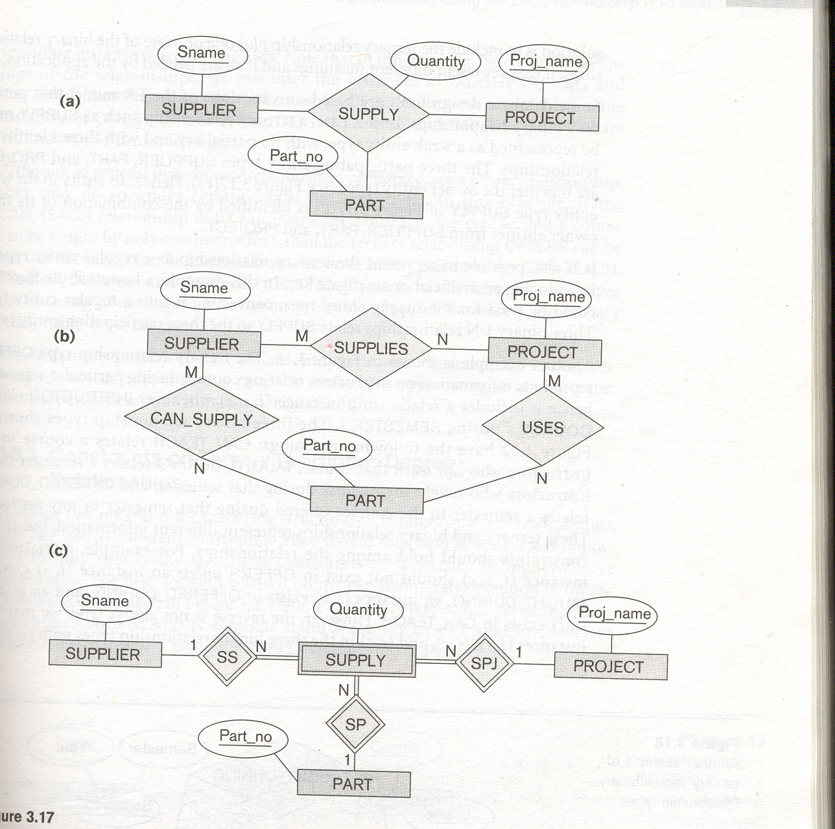

Slide 35
Constraints on Ternary (or Higher-degree relationships
Two notations for specifying structural constraints on n-ary relationships:
Cardinality ratio notation. A 1 , M or N is specified on each participation arc
(min, max) notation

Slide 36
PROBLEM with ER notation
THE ENTITY RELATIONSHIP MODEL IN ITS ORIGINAL FORM DID NOT SUPPORT THE GENERALIZATION ABSTRACTION.

Slide 37
Extended Entity-Relationship (EER) Model
Incorporates Set-subset relationships
Incorporates Specialization/Generalization Hierarchies
NEXT PART ILLUSTRATES HOW THE ER MODEL CAN BE EXTENDED WITH
Set-subset relationships and
Specialization/Generalization Hierarchies and how to display them in EER diagrams

Slide 38
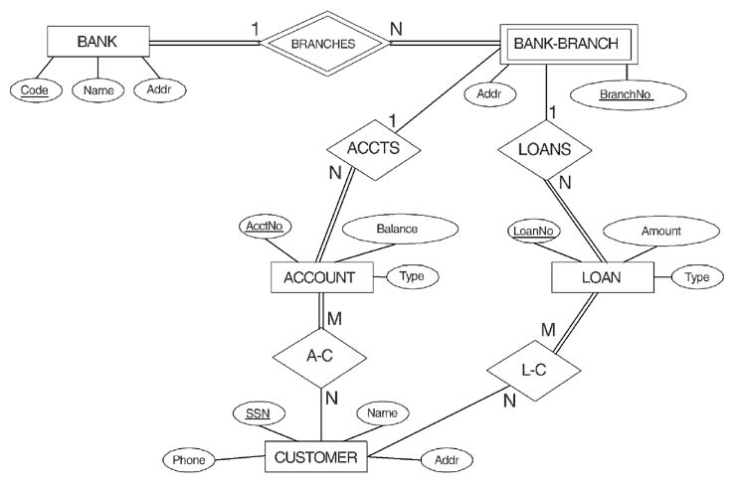
ER DIAGRAM FOR A BANK
DATABASE ( Problem 3.23)

Slide 39
Homework
Exercise Question 3.16 to 3.23

